Slide 1

SMART INDIA HACKATHON 2025
TITLE PAGE
Problem Statement ID – | 25002
Problem Statement Title- | SMART TOURIST SAFETY MONITORING AND INCIDENT RESPONSE SYSTEM USING AI ,GEO-FENCING AND BLOCKCHAIN-BASED DIGITAL ID
Theme- | TRAVEL & TOURISM
PS Category- | SOFTWARE
Team ID-
Team Name (Registered on portal) | COMPILERS

Slide 2
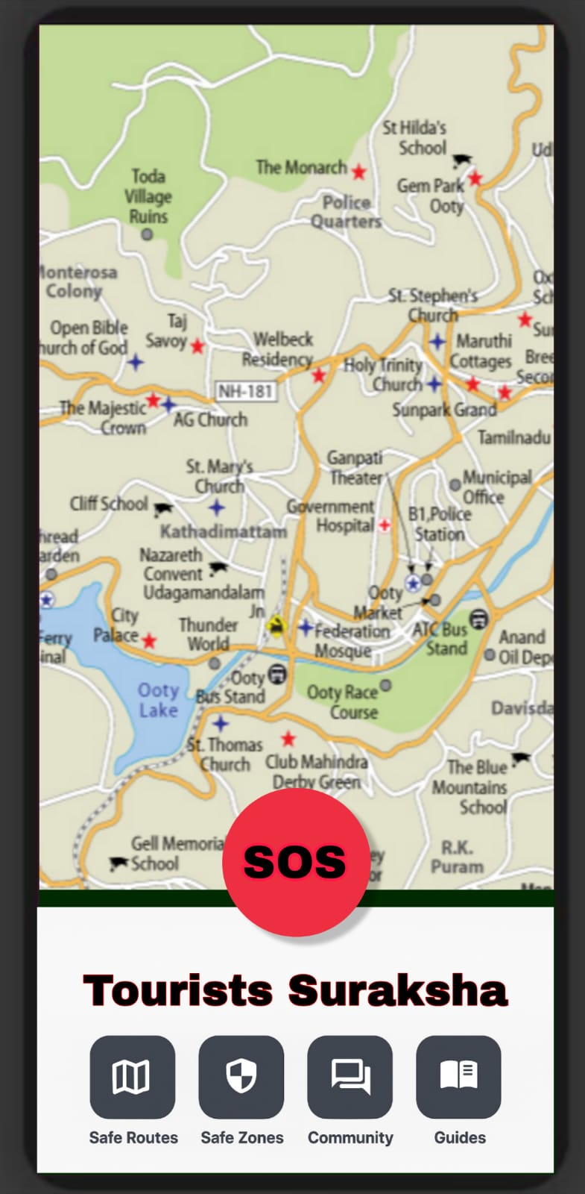
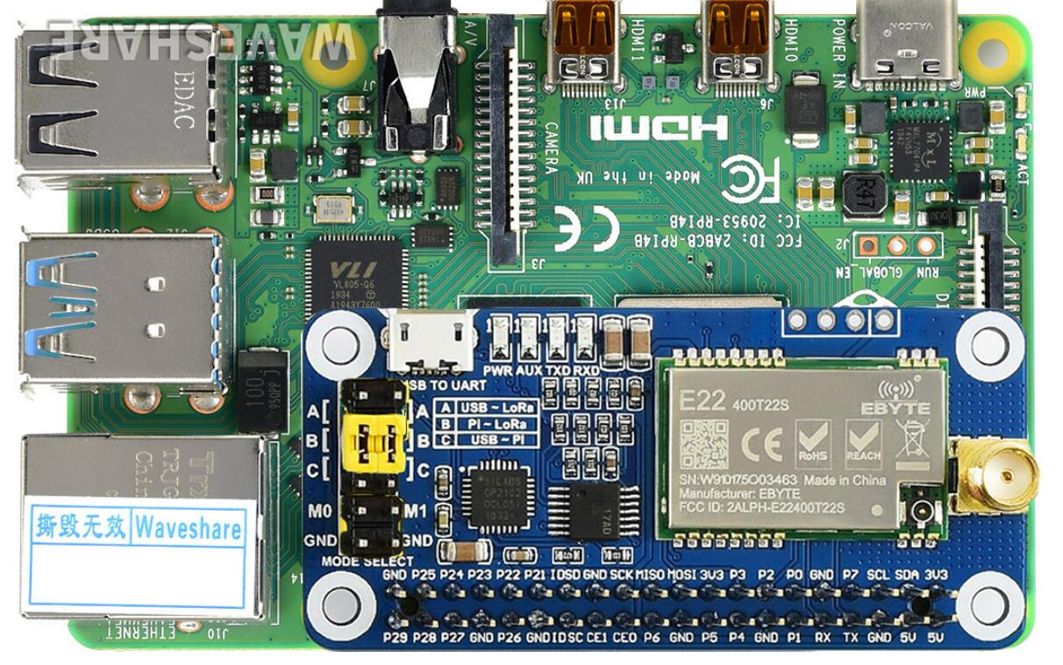
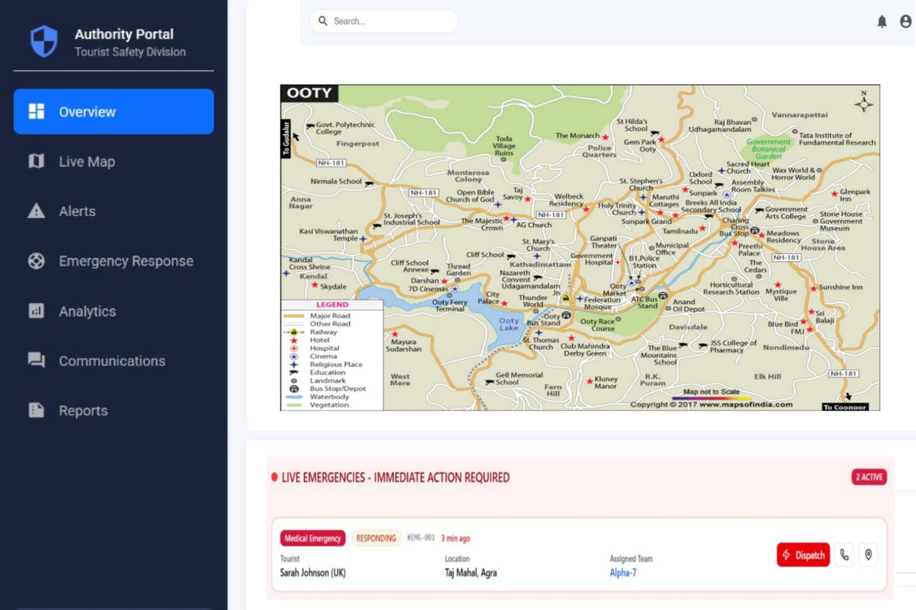
IDEA TITLE
COMPILERS
PROPOSED IDEA:
Blockchain-based secure digital ID
Smart safety & incident response for tourists
AI-driven monitoring & risk detection
Geo-fencing for safe zone alerts
PROTOTYPE:
PROPOSED SOLUTION:
AI analytics for real-time risk alerts
Geo-fencing to trigger instant warnings
Blockchain digital ID for secure verification
Rapid incident response with authority integration
Tourist app + authority dashboard for monitoring
Data privacy ensured with blockchain & encryption

Slide 3
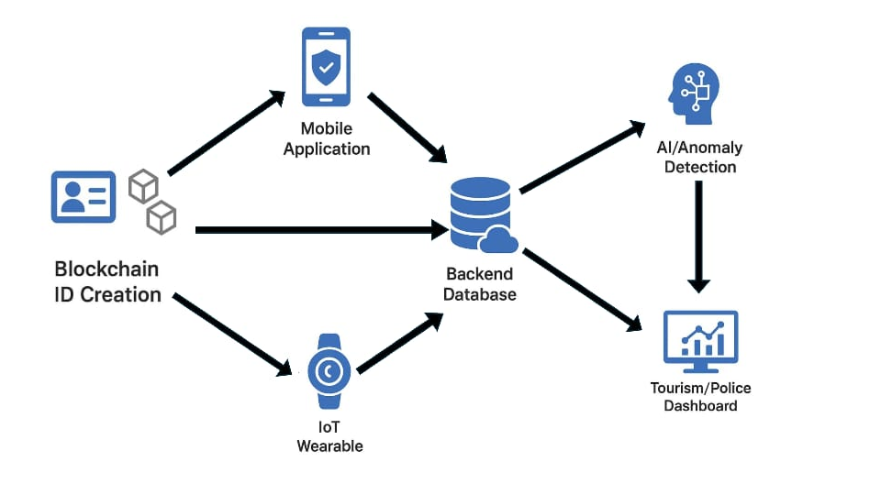
TECHNICAL APPROACH
COMPILERS
TECHNOLOGY USED:
Frontend:
Tourist app: react native / flutter
Tourist Dashboard : HTML | CSS | Java script |
Backend:
Node.js | Express.js
Firebase | AWS
Ethereum (Blockchain)
Al & Analytics:
Python (TensorFlow | PyTorch)
Database:
PostgreSQL | MongoDB
Hardware:
Lora Module | Raspberry | GPS Module | Battery
FLOW CHART

Slide 4
FEASIBILITY AND VIABILITY
COMPILERS
ANALYSIS OF THE FEASIBILITY OF THE IDEA:
AI, Geo-fencing, and Blockchain are accessible and proven.
Real-time monitoring possible with existing IoT + GPS.
Mobile and web deployment ensures ease of adoption.
POTENTIAL CHALLENGES AND RISKS :
Network issues in remote tourist zones.
Data security and privacy concerns.
STRATERGIES FOR OVERCOMING THESE CHALLENGES :
Use of LoRa or offline alerts in low-connectivity areas.
Blockchain + encryption for secure data management.

Slide 5
IMPACT
COMPILERS
BENEFITS
Safety & Trust:
Enhances tourist safety with real-time monitoring, geo-fencing, and secure digital
IDs
Delivers a secure and trusted travel experience that enhances tourist confidence, stimulates sustainable growth in the tourism industry.
Safeguards ecologically sensitive areas through smart geo-fencing, and fosters digital transformation by leveraging AI and blockchain technologies.
Growth & Innovation:
Boosts tourism industry growth through sustainable and secure travel.

Slide 6
RESEARCH AND REFERENCES
COMPILERS
Iori Sasaki, Masatoshi Arikawa, Min Lu, Tomihiro Utsumi, and Ryo Sato, Hierarchical geofencing for location-aware generative audio tours, Urban Informatics, vol. 3, article no. 33, 2024.
Varsha Patil, Adesh More, Mitali Mahajan, and Hemant Gholap. “AI and IoT Based Road Accident Detection and Reporting System.” International Journal for Research in Applied Science & Engineering Technology (IJRASET), vol. 11, no. V, pp. 6977–6982, May 2023.
S. Balasubramanian, J. S. Sethi, S. Ajayan and C. M. Paris, An enabling framework for blockchain in tourism, Inf. Technol. Tourism, vol. 24, no. 2, pp. 165–179, 2022.
V. Puri, S. Mondal, S. Das and V. G. Vrana, Blockchain propels tourism industry—An attempt to explore topics and information in smart tourism management through text mining and machine learning, Informatics, vol. 10, no. 1, p. 9, 2023

